Slide 1
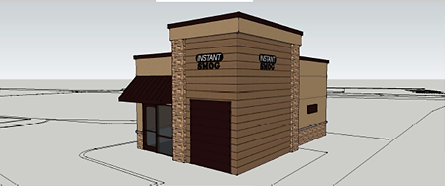
Washoe County Board of Adjustment
April 6, 2017
Administrative Permit Case Number: WADMIN17-0001 (Instant Smog)

Slide 2
Case Description
For possible action, hearing, and discussion, to approve an administrative permit for an Auto Repair use in the General Commercial zoning district. The proposed Auto Repair use would be within a 405 square foot smog check building located in the southwest corner of the parcel.

Slide 3
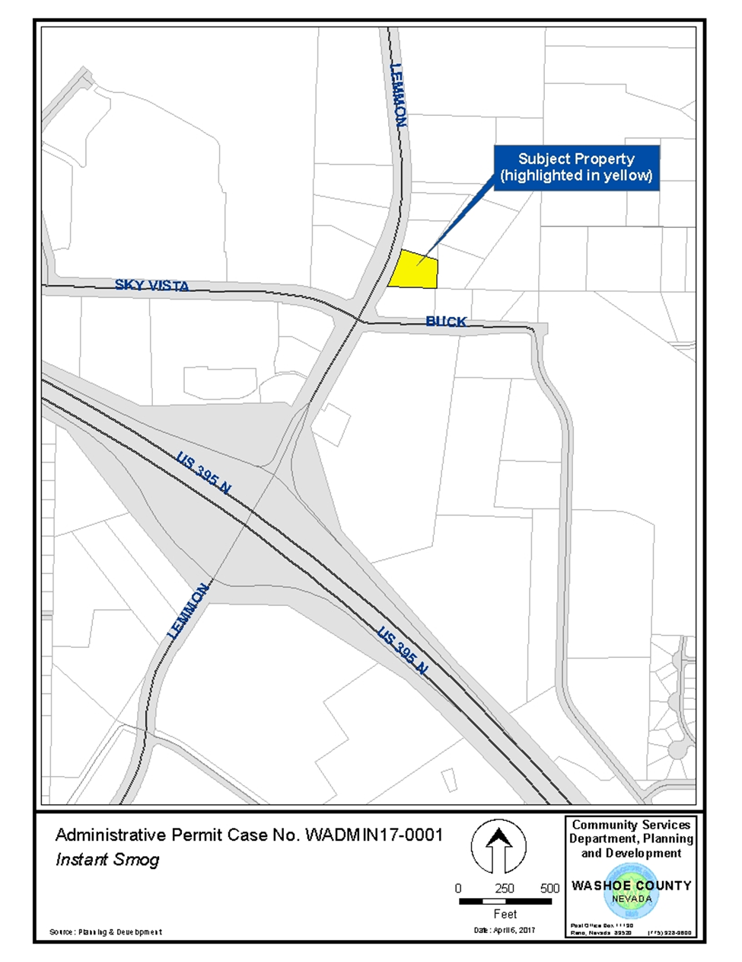
Vicinity Map

Slide 4
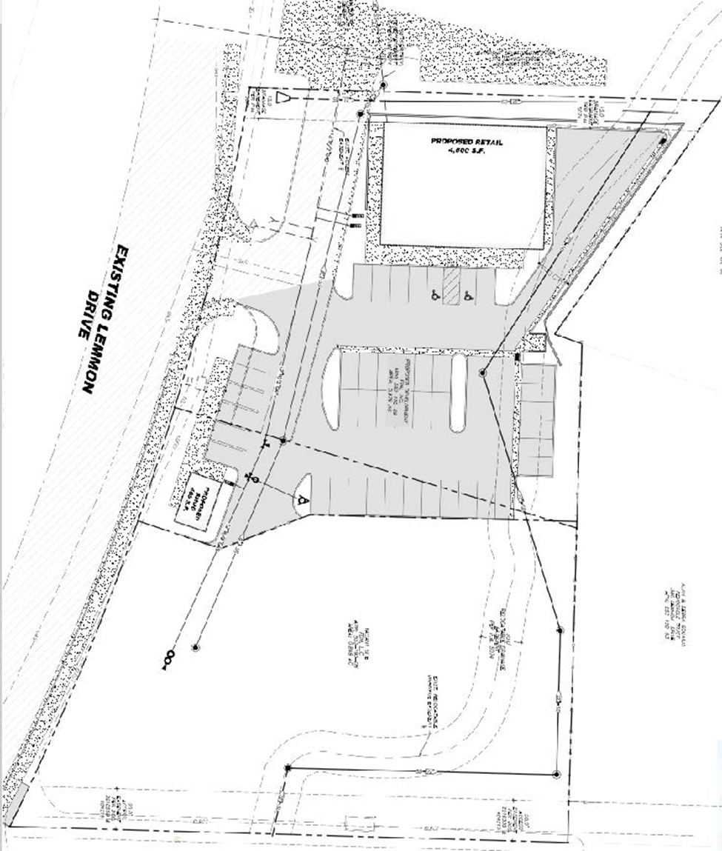
Site Plan

Slide 5
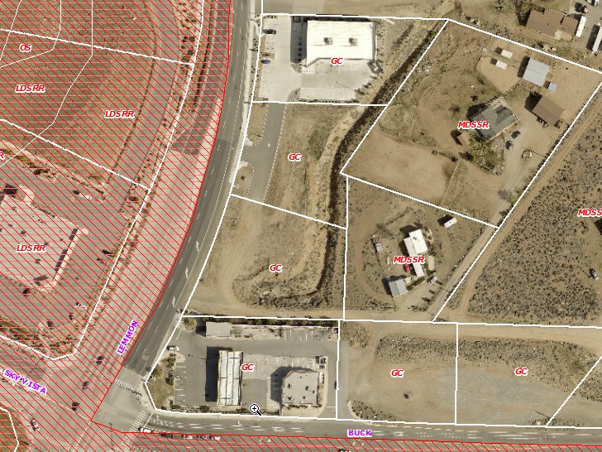
Overhead Photo of Subject Site

Slide 6
Background
The subject property is zoned General Commercial (GC). Automotive Repair is a commercial use type defined in WCC 110.304.25, and the proposed use meets this definition. Automotive Repair is allowed in the GC zone only with a Board of Adjustment Administrative Permit per WCC Table 110.302.05.3. The applicant is therefore seeking approval from the Board of Adjustment of the proposed Administrative Permit.

Slide 7
Analysis
No concerns, objections, or recommendations from surrounding property owners
Low intensity use
No repair will take place
Simple diagnostic testing required for vehicle registration

Slide 8
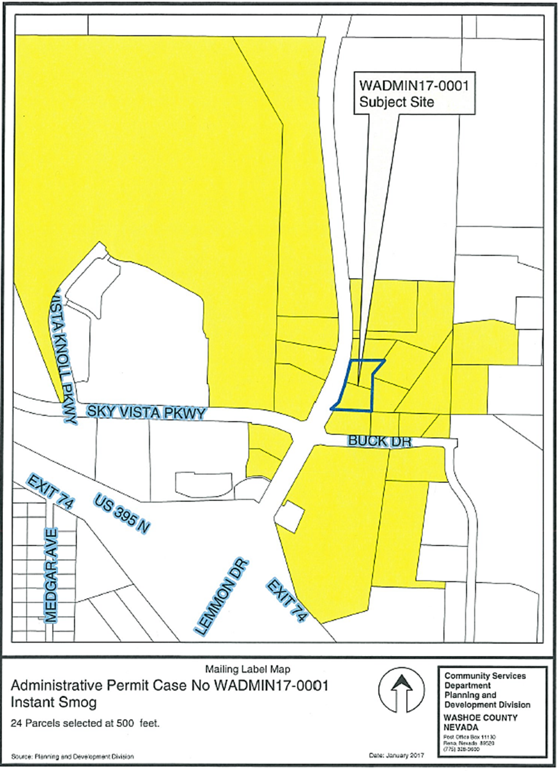
Public
Notice

Slide 9
Conditions of Approval
Staff is proposing minimal conditions of approval regarding aesthetics, limited to requiring that the proposed structure be painted an earth tone color to blend in with natural surroundings and that the wall or fence required between the commercial and adjacent residential uses be of long-lasting materials.

Slide 10
Administrative Permit Findings

Slide 11
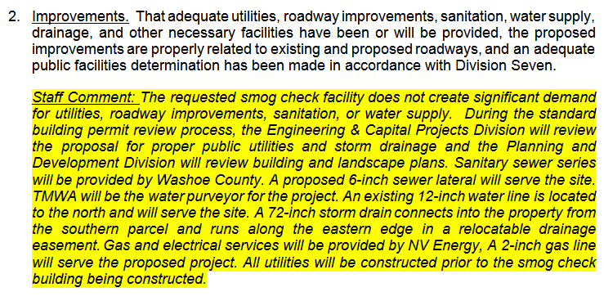
Administrative Permit Findings

Slide 12
Administrative Permit Findings

Slide 13
Administrative Permit Findings

Slide 14
Administrative Permit Findings

Slide 15
Recommendation
Those agencies which reviewed the application either made no comments or recommended conditions in support of approval of the project. Therefore, after a thorough analysis and review, Administrative Permit Case Number WADMIN17-0001 is being recommended for approval with conditions.

Slide 16
Possible Motion
I move that, after giving reasoned consideration to the information contained in the staff report and information received during the public hearing, the Board of Adjustment approve Administrative Permit Case Number WADMIN17-0001 for FDM LLC, Frank Lepori, having made all five findings in accordance with Washoe County Development Code Section 110.808.25

Slide 17
Questions?

